Slide 1
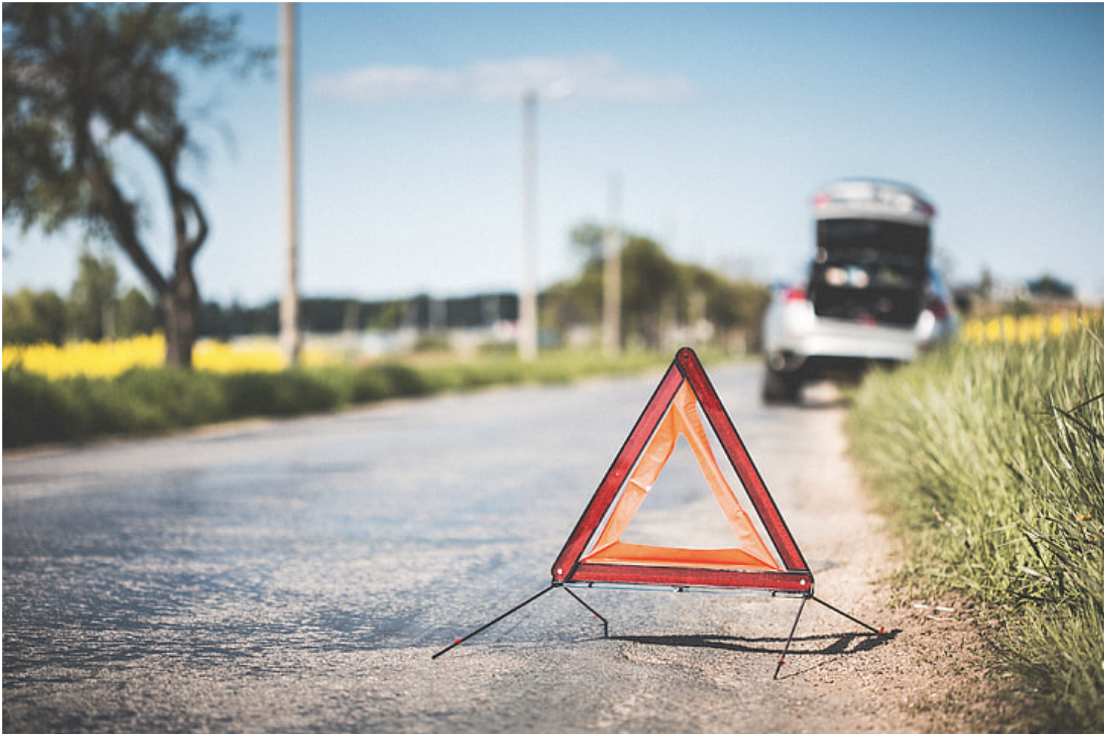


Predicting Severity of road accidents Elizabeth Kelley, Jack Wagner, Supriyo Ghosh, Tristan Freiberg
THE ERDŐS INSTITUTE
DATA SCIENCE BOOTCAMP, SPRING 2024
GitHub Repository

Slide 2
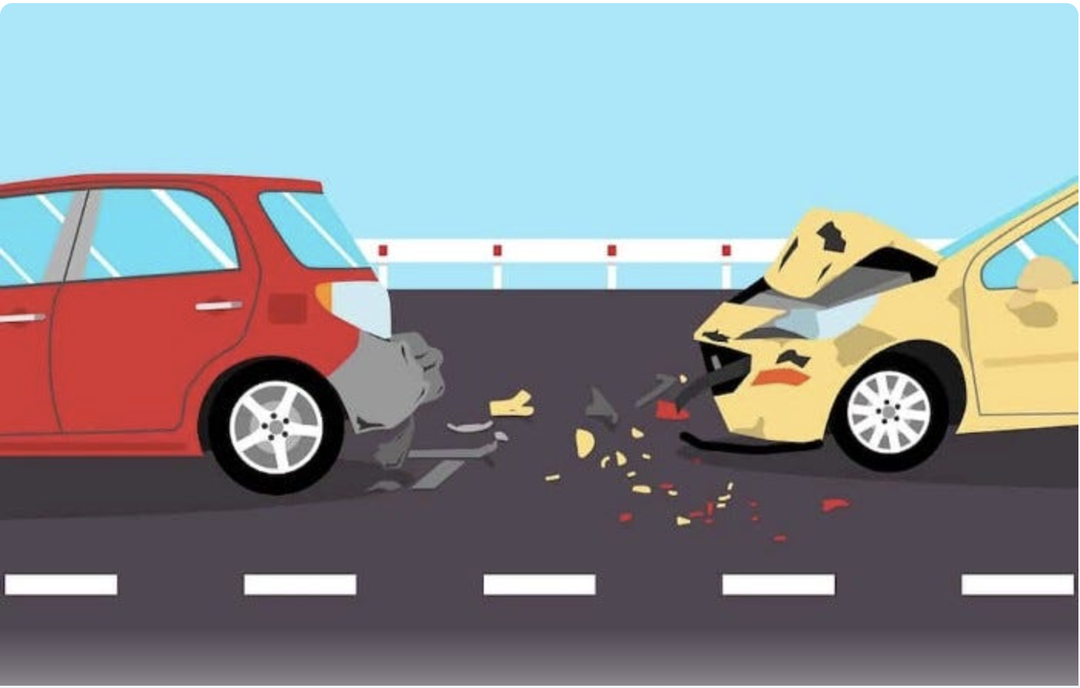
INTRODUCTION
Predict traffic accident severity → improve emergency response protocols/urban planning strategies.
300,000 traffic accidents based on police reports filed in Montreal between 2011 and 2022 (source: QUEBEC AUTOMOBILE INSURANCE SOCIETY [SAAQ]).
GOAL. Classify severity level of a traffic accident as:
0. material damage only (no injuries)
1. minor injuries
2. serious/fatal injuries

Slide 3
STAKEHOLDERS
911 dispatchers: better emergency response coordination
Urban planners: Vision Zero strategies, reducing the frequency/severity of road accidents

Slide 4
FEATURES
Temporal: month, weekend/weekday, hour,…
Environmental: weather, light conditions,…
Road conditions and built-environment: speed limit, one-way versus two-way street, school zone/residential zone,…
Road users/vehicle: pedestrian, cyclist, motorcyclist, light truck, heavy vehicle,…
Nature of the accident: single vehicle, collision with fixed object, animal,…

Slide 5
Model selection
XGBoost was chosen as a classifier for our ternary classification problem.
Imbalanced dataset: 1% of accidents are serious/fatal, 20% are minor.
2. Speed and Efficiency
3. Missing Values
4. Feature Interaction Handling

Slide 6

METRIC
Weighted class-wise average $F^{2}$score:
$$F_{2}^{∗}= \frac{F_{2}^{0}+2F_{2}^{1}+3F_{2}^{2}}{1+2+3}$$
Recall and precision both important, but recall more so.
Higher severity, more important.

Slide 7
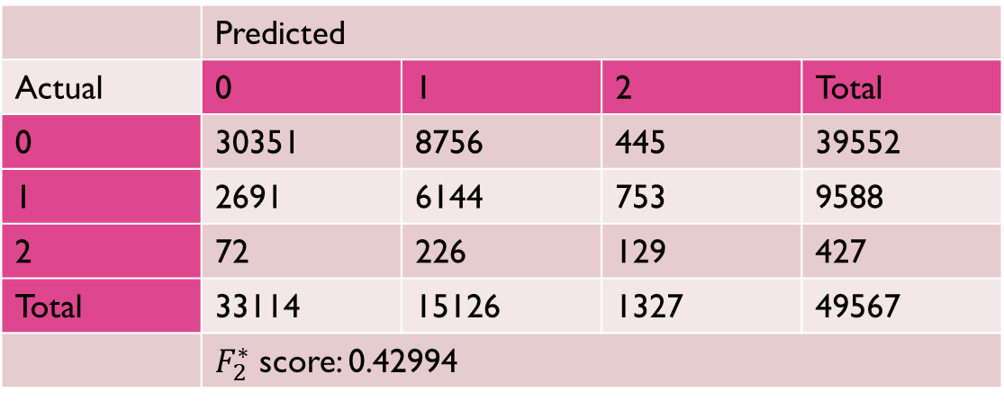
Evaluation
5-fold cross-validation
Grid search
Oversampling of minority classes
Evaluation on test set
 | Predicted
Actual | 0 | 1 | 2 | Total
0 | 30351 | 8756 | 445 | 39552
1 | 2691 | 6144 | 753 | 9588
2 | 72 | 226 | 129 | 427
Total | 33114 | 15126 | 1327 | 49567
 | $F_{2}^{∗}$ score: 0.42994

Slide 8
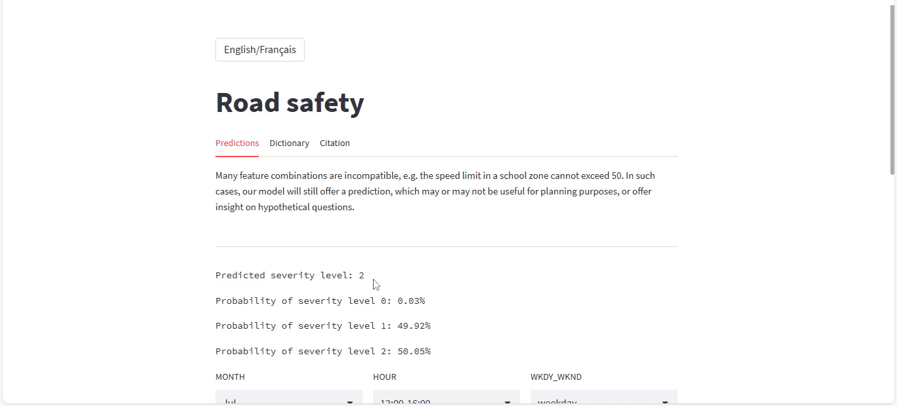
Streamlit application

Slide 9
Potential Future Directions
Data from other regions
Different features: better models?

Slide 10
Acknowledgements
Our thanks to:
Dr. Adam Kawash, for his mentorship.
The Erdős Institute, for the opportunity and support!

